Slide 1

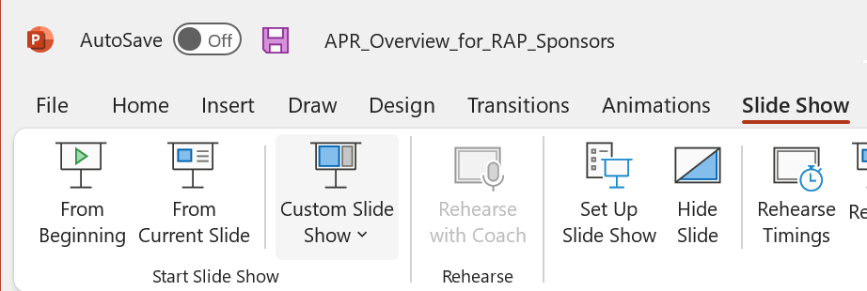

NOTE: FOR BEST RESULTS, PLAY AS A SLIDESHOW
1
2
To begin the training:
1) Select the Slide Show tab (top menu bar)
2) Select From Beginning (far left option)
This training program uses audio extensively.
Make sure you have your headphones or speaker on.
Notes:
This screen needed for audio playback purposes. DO NOT DELETE!

Slide 2




Understanding Apprenticeship Program Reviews (APRs)
WELCOME
Estimated time to complete: 30 minutes
for
Registered Apprenticeship Program (RAP) Sponsors and Industry Intermediaries
NEXT >

Slide 3
3
Notes:
This screen needed for audio playback purposes. DO NOT DELETE!

Slide 4

Learning Objectives
After completing this training, you will be able to:
Explain what an Apprenticeship Program Review is and identify its purpose.
Recall the sponsor’s responsibilities related to program reviews.
Recognize and describe the three components of a program review.
Identify sponsors’ options in responding to a Notice of Review
Findings with discrepancies.
Explain the purpose of and distinguish between the three types of demographic analyses.
< PREV
NEXT: Overview >

Slide 5
5
Notes:
This screen needed for audio playback purposes. DO NOT DELETE!

Slide 6
Overview of the Program Review
Purpose, Timing, and Tools
< PREV
NEXT: Definition >

Slide 7
7
Notes:
This screen needed for audio playback purposes. DO NOT DELETE!

Slide 8



What is an Apprenticeship Program Review?
    A comprehensive assessment of all aspects of the program’s:
    Performance
    Operations
    Administration
    Practices
< PREV
NEXT: Types >

Slide 9
9
Notes:
This screen needed for audio playback purposes. DO NOT DELETE!

Slide 10

Two Types of Program Reviews
    Apprenticeship Program Review (APR)
    Applies to all RAP sponsors
      FOCUS: Sponsor’s overall performance and compliance with provisions in 29 CFR part 29, and those in part 30 that apply to all RAPs
    Extended Apprenticeship Program Review (EAPR)
    Applies to certain RAP sponsors
      FOCUS: Sponsor’s compliance with
      aspects of 29 CFR part 30 that apply only to sponsors with five or more apprentices and who are required to develop an Affirmative Action Plan (AAP)
< PREV
NEXT: Purpose >

Slide 11
11
Notes:
This screen needed for audio playback purposes. DO NOT DELETE!

Slide 12

Two-Fold Purpose of Program Reviews
1
    To assess the overall condition of a sponsor’s program and compliance with its registered Standards and the governing regulations.
    This includes determining if apprentices are receiving:
On-the-job training
Scheduled wage increases
Appropriate related instruction
Equal opportunity
2
    To provide support and technical assistance to help sponsors in complying with the federal regulations.
Sponsors are encouraged to take advantage of the support offered by the registration agency.
< PREV
NEXT: Timing >

Slide 13
13
Notes:
This screen needed for audio playback purposes. DO NOT DELETE!

Slide 14

Timing of Program Reviews
    Program reviews are conducted as follows:
    End of 1st year of program operation (Provisional)
    End of 1st full training cycle
    Subsequently at least once in every 5-year span
    Outside planned review schedule if the registration agency receives:
    Credible information of a sponsor’s failure to conform to its Standards or to relevant CFR regulations
    A written complaint of a sponsor’s failure to conform
< PREV
NEXT: APR Tool >

Slide 15
15
Notes:
This screen needed for audio playback purposes. DO NOT DELETE!

Slide 16
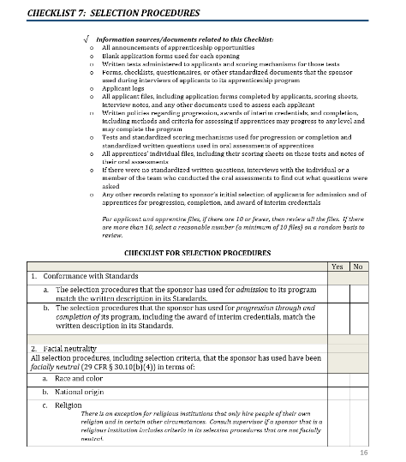
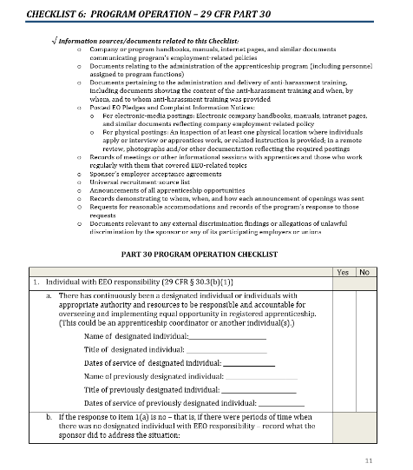
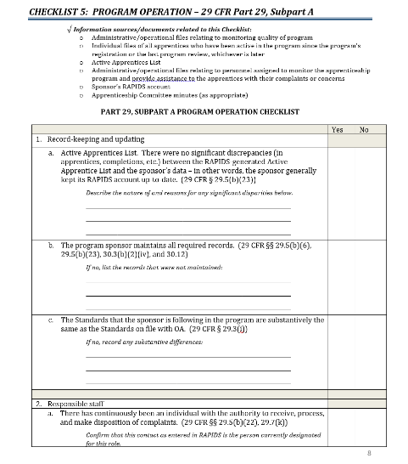
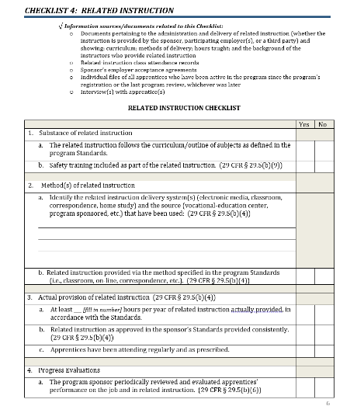
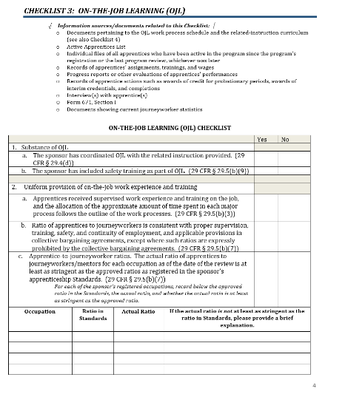
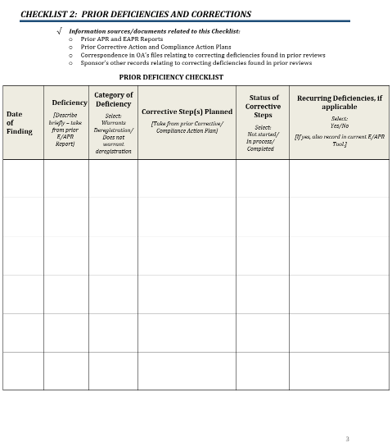
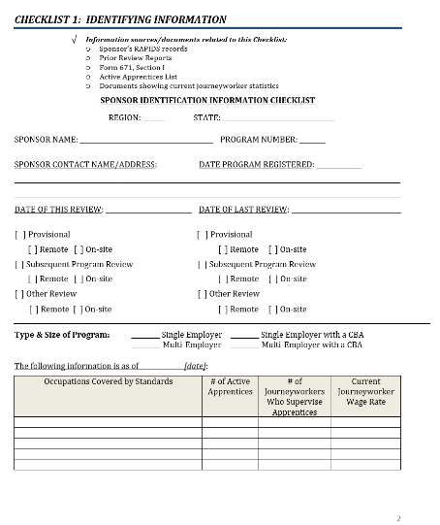
Documenting Program Reviews – APR Tool
    7
    Checklists
The APR Tool is used for all program reviews.
Guide the reviewer through the program review
Identifying Information
Prior Deficiencies and Corrections
On-the-Job Learning (OJL)
Related Instruction
Program Operation
(29 CFR Part 29)
Program Operation
(29 CFR Part 30)
Selection Procedures
< PREV
NEXT: EAPR Tool >

Slide 17
17
Notes:
This screen needed for audio playback purposes. DO NOT DELETE!

Slide 18
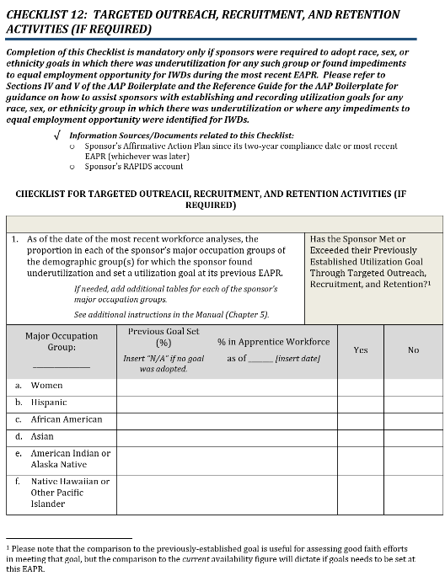
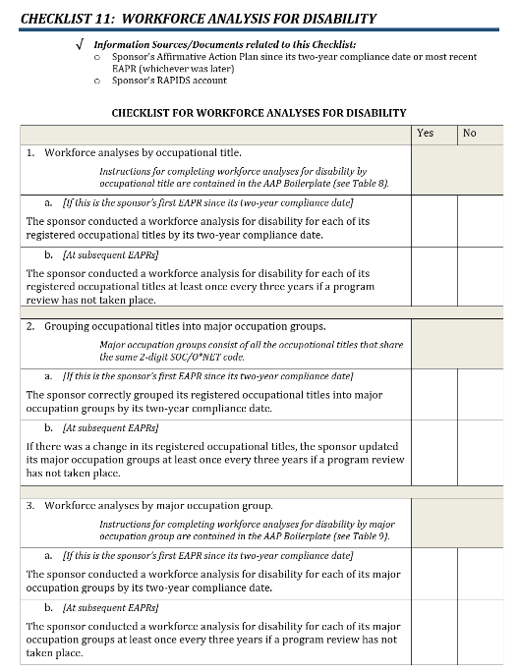
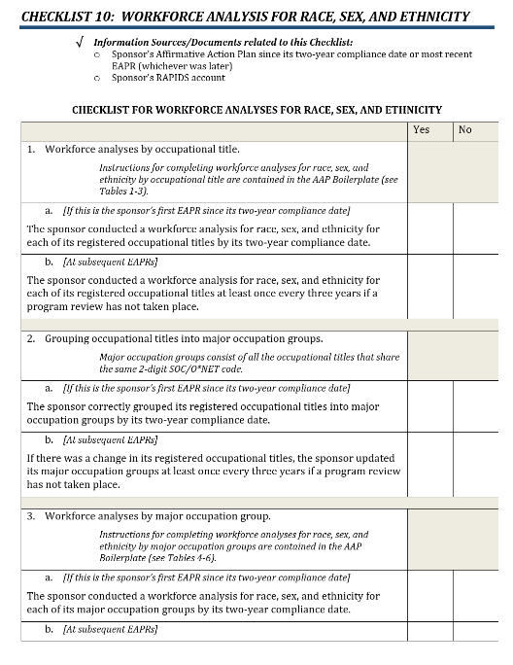
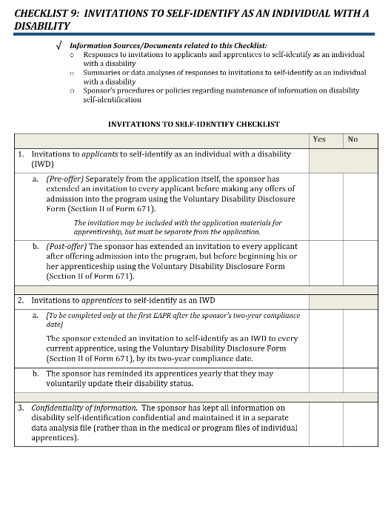
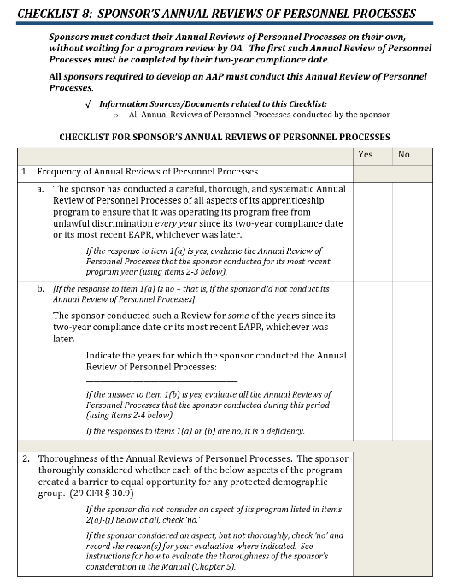
Documenting Program Reviews – EAPR Tool
    5
    Checklists
Annual Reviews of Personnel Processes
Invitations to Self-Identify as an Individual with a Disability
Workforce Analysis for Race, Sex, and Ethnicity
Workforce Analysis for Disability
Targeted Outreach, Recruitment, and Retention Activities (if Required)
< PREV
NEXT: Check Your Knowledge >

Slide 19
19
Notes:
This screen needed for audio playback purposes. DO NOT DELETE!

Slide 20

Check Your Knowledge
QUESTION 1 OF 3
What are the two types of program reviews conducted by the registration agency?
Select the correct answer.
Apprenticeship Program Evaluation (APE) & Apprenticeship Program Evaluation and Assessment (APEA)
Registered Apprenticeship Program Review (RAPR) & Extended Registered Apprenticeship Program Review (ERAPR)
Registration Agency Review (RAR) & Registration Agency Compliance Review (RACR)
Apprenticeship Program Review (APR) & Extended Apprenticeship Program Review (EAPR)
< PREV
NEXT: Question 2 >

Slide 21
Check Your Knowledge – Question 1 Feedback
QUESTION 1 OF 3
What are the two types of program reviews conducted by the registration agency?
Apprenticeship Program Evaluation (APE) & Apprenticeship Program Evaluation and Assessment (APEA)
Apprenticeship Program Evaluation (APE) & Apprenticeship Program Evaluation and Assessment (APEA)
Registered Apprenticeship Program Review (RAPR) & Extended Registered Apprenticeship Program Review (ERAPR)
Registered Apprenticeship Program Review (RAPR) & Extended Registered Apprenticeship Program Review (ERAPR)
Registration Agency Review (RAR) & Registration Agency Compliance Review (RACR)
Registration Agency Review (RAR) & Registration Agency Compliance Review (RACR)
✓
Apprenticeship Program Review (APR) & Extended Apprenticeship Program Review (EAPR)
Registration agencies conduct Apprenticeship Program Reviews (APRs) and Extended Apprenticeship Program Reviews (EAPRs).
Click NEXT for Question 2.
< PREV
NEXT: Question 2 >

Slide 22
Check Your Knowledge
QUESTION 2 OF 3
True or False?
The focus of the APR is to evaluate a sponsor’s compliance with aspects of 29 CFR part 30 that apply only to sponsors with five or more apprentices and who are required to develop an Affirmative Action Plan (AAP).
Select the correct answer.
True
False
< PREV
NEXT: Question 3 >

Slide 23
Check Your Knowledge – Question 2 Feedback
QUESTION 2 OF 3
True or False?
The focus of the APR is to evaluate a sponsor’s compliance with aspects of 29 CFR part 30 that apply only to sponsors with five or more apprentices and who are required to develop an Affirmative Action Plan (AAP).
This statement is false. The focus of the APR is to evaluate a sponsor’s overall performance and their compliance with provisions in 29 CFR part 29, and those in part 30 that apply to all RAPs.
The focus of the EAPR is to evaluate a sponsor’s compliance with aspects of 29 CFR part 30 that apply only to sponsors with five or more apprentices and who are required to develop an AAP.
Click NEXT for Question 3.
True
True
✓
False
< PREV
NEXT: Question 3 >

Slide 24
Check Your Knowledge
QUESTION 3 OF 3
When is the first (provisional) program review conducted?
Select the correct answer.
At the end of the program’s first year of program operation
Within a month of the program’s registration with the registration agency
At the end of the program’s first full training cycle
At the end of the program’s second full training cycle
< PREV
NEXT: Components >

Slide 25
Check Your Knowledge – Question 3 Feedback
QUESTION 3 OF 3
When is the first (provisional) program review conducted?
✓
At the end of the program’s first year of program operation
The first program review is conducted at the end of the apprenticeship program’s first year of program operation. This first review is called a provisional review. The next review occurs, at the end of the program’s first full training cycle, and subsequently, on a cyclical basis, at least once every five years.
Click NEXT to continue.
Within a month of the program’s registration with the registration agency
Within a month of the program’s registration with the registration agency
At the end of the program’s first full training cycle
At the end of the program’s first full training cycle
At the end of the program’s second full training cycle
At the end of the program’s second full training cycle
< PREV
NEXT: Components >

Slide 26
26
Notes:
This screen needed for audio playback purposes. DO NOT DELETE!

Slide 27
Components of the Program Review
Key Activities and Tasks
< PREV
NEXT: 3 Components >

Slide 28
28
Notes:
This screen needed for audio playback purposes. DO NOT DELETE!

Slide 29



3 Components of a Program Review
Select a component to learn more.
Desk Review
In-Person Review
Analysis of Findings
< PREV
NEXT: Desk Review >

Slide 30
30
Notes:
This screen needed for audio playback purposes. DO NOT DELETE!

Slide 31

1) DESK REVIEW
1) DESK REVIEW
1 of 3
1 of 3
3 Components of a Program Review
Desk Review Activities
During the desk review the registration agency:
Gathers and reviews the RAP’s documents
and data.
May request more information.
Contacts the sponsor’s designated representative to schedule the in-person
review and coordinate logistics.
MORE
< PREV

Slide 32
32
Notes:
This screen needed for audio playback purposes. DO NOT DELETE!

Slide 33
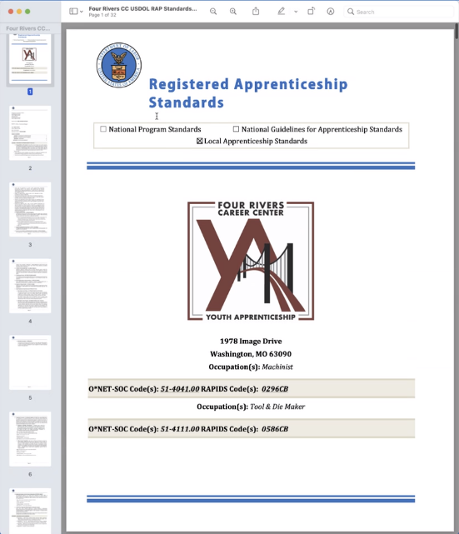
Registered Standards
1) DESK REVIEW
2 of 3
3 Components of a Program Review
The reviewer will check the sponsor’s registered Standards for alignment with applicable EEO regulations, such as:
Ratio of apprentices to journeyworkers
EEO pledge
Selection procedures and qualification requirements
Current wage table
MORE
Sponsors are responsible for keeping their registered Standards current in RAPIDS.
< PREV

Slide 34
34
Notes:
This screen needed for audio playback purposes. DO NOT DELETE!

Slide 35

Notice of Review
1) DESK REVIEW
3 of 3
3 Components of a Program Review
    The registration agency will send the sponsor a Notice of Review.
Select the next component.
    The Notice will include:
    Purpose and components of the review
    Time period the review will cover
    Date and time of the review
    Request for any relevant documentation and how to send them
    Whether the review will be conducted remotely or on-site
    Reminder to make apprentices and others available for interviews
    Reviewer’s name and contact information
< PREV
NEXT: In-Person Review >

Slide 36
36
Notes:
This screen needed for audio playback purposes. DO NOT DELETE!

Slide 37


2) IN-PERSON REVIEW
1 of 4
3 Components of a Program Review
On-site
Remotely
OR
The in-person review helps the registration agency gain a complete picture of the apprenticeship program’s operations and the apprentices’ experience.
MORE
Click each tab for a list of activities that occur in each type of program review.
APR Activities
EAPR Activities
< PREV

Slide 38
APR Activities
2) IN-PERSON REVIEW
1 of 4
3 Components of a Program Review
On-site
Remotely
OR
The in-person review helps the registration agency gain a complete picture of the apprenticeship program’s operations and the apprentices’ experience.
EAPR Activities
MORE
During the in-person review for an APR, the registration agency staff member will:
Meet with the sponsor’s designated representative to verify, clarify, and fill in any gaps in the information gathered during the desk review.
Review the sponsor’s required records and files.
Interview at least one apprentice and others as appropriate (e.g., journeyworkers, supervisors, managers, etc.).
Conduct a visual check of at least one worksite, if appropriate.
Conduct a visual check of the related instruction training site, if appropriate.
Provide technical assistance as needed to support the sponsor in complying with 29 CFR part 29, and the provisions in 29 CFR part 30 that apply to all RAPs.
< PREV

Slide 39
EAPR Activities
2) IN-PERSON REVIEW
1 of 4
3 Components of a Program Review
On-site
Remotely
OR
The in-person review helps the registration agency gain a complete picture of the apprenticeship program’s operations and the apprentices’ experience.
APR Activities
MORE
In addition to the activities conducted for an APR, during an EAPR, the reviewer will:
Provide technical assistance as needed to support the sponsor in complying with those parts of 29 CFR part 30 that apply to sponsors with five or more apprentices and who are required to develop an Affirmative Action Plan.
Conduct or review the sponsor’s demographic analyses.
Review any prior demographic analyses and determine whether the sponsor had any underutilized groups.
If applicable, review the sponsor’s progress toward their utilization goals.
If applicable, work with the sponsor’s representative to establish goals for targeted outreach, recruitment, and retention activities.
< PREV

Slide 40
40
Notes:
This screen needed for audio playback purposes. DO NOT DELETE!

Slide 41






Safety and Diversity, Equity, Inclusion, and Accessibility (DEIA)
2) IN-PERSON REVIEW
2 of 4
3 Components of a Program Review
Examples of Safety Checks
Examples of DEIA Checks
  Proper safety equipment
  No visible hazards
  Adequate lighting, heating, and cooling
  Sanitary restrooms and food areas
  Proper ratios of apprentices to journeyworkers
  No visual indications of unwelcoming, intimidating,
  or harassing conduct
  Accessibility/reasonable accommodations
  Proper placement of EEO Pledge and EEO Complaints Information Notice posters
MORE
< PREV

Slide 42
42
Notes:
This screen needed for audio playback purposes. DO NOT DELETE!

Slide 43

Sponsor Responsibilities (APR and EAPR)
2) IN-PERSON REVIEW
3 of 4
3 Components of a Program Review
The sponsor or their representative has responsibilities for the in-person review, including:
Provide program and apprenticeship records for review, as requested.
Answer the reviewer’s questions to clarify, verify, or fill in gaps in information needed.
Make available for interview the apprentices and any others (e.g., journeyworkers mentors, supervisors, etc.) previously agreed upon.
Conduct demographic analyses (for EAPR only).
Establish goals for targeted outreach, recruitment, and retention activities (if required).
MORE
< PREV

Slide 44
44
Notes:
This screen needed for audio playback purposes. DO NOT DELETE!

Slide 45


Affirmative Action Plan (for EAPR only)
2) IN-PERSON REVIEW
4 of 4
3 Components of a Program Review
Four major elements of an AAP are:
Description of the sponsor’s annual review of personnel practices and any modifications.
Select the next component.
When and how the sponsor will invite apprentices and applicants to self-identify as having a disability.
Demographic analyses results for race, sex, ethnicity, and disability.
The initial AAP must be completed by the program’s two-year registration anniversary date.
Targeted outreach and recruitment plans for underutilized groups (if required).
< PREV
NEXT: Analysis of Findings >

Slide 46
46
Notes:
This screen needed for audio playback purposes. DO NOT DELETE!

Slide 47

3) ANALYSIS OF FINDINGS
1 of 6
3 Components of a Program Review
Analysis of Findings Activities
During the Analysis of Findings, the registration agency:
Reviews the information gathered.
Determines whether there are any deficiencies.
Develops recommendations for correcting
any deficiencies.
Prepares and sends a Notice of Review Findings.
MORE
< PREV

Slide 48
48
Notes:
This screen needed for audio playback purposes. DO NOT DELETE!

Slide 49
Defining Deficiencies
3) ANALYSIS OF FINDINGS
2 of 6
3 Components of a Program Review
Deficiencies are the sponsor’s failure to:
Comply with a specific provision in CFR Part 29 or 30.
Conduct its program according to its registered Standards.
Not all deficiencies warrant:
A consequence.
A finding of non-compliance.
Items in question will be factored with other circumstances.
What constitutes a deficiency?
There is no deficiency unless there is a violation of a specific provision in the regulations or the program’s Standards.
MORE
The registration agency may simply require that the sponsor correct the deficiency and may provide technical assistance if needed.
EXAMPLE
< PREV

Slide 50
50
Notes:
This screen needed for audio playback purposes. DO NOT DELETE!

Slide 51
Notice of Review Findings
3) ANALYSIS OF FINDINGS
3 of 6
3 Components of a Program Review
The Notice of Review Findings will include (as applicable):
Deficiency(ies) identified.
How to remedy the deficiency(ies).
Timeframe for correcting deficiency(ies).
Potential consequences of failing to make corrections by the stated deadline.
✓
✓
MORE
✓
✓
< PREV

Slide 52
52
Notes:
This screen needed for audio playback purposes. DO NOT DELETE!

Slide 53
Sponsor Timelines to Respond
3) ANALYSIS OF FINDINGS
4 of 6
3 Components of a Program Review
The sponsor has deadlines for responding to a Notice of Review Findings with deficiencies that must be corrected.
 | 29 CFR Part 29 | 29 CFR Part 30
Option 1 | [CORRECTIVE ACTION PERIOD] Take corrective measures to correct deficiencies | Submit a Compliance Action Plan
Option 2 | None | Submit a written rebuttal
Deadline | Within 30 calendar days | Within 30 business days
Deadline Extension | Another 30 days for good cause | Another 30 days for good cause
MORE
< PREV

Slide 54
54
Notes:
This screen needed for audio playback purposes. DO NOT DELETE!

Slide 55
Sponsor’s Compliance Action Plan
3) ANALYSIS OF FINDINGS
5 of 6
3 Components of a Program Review
The Compliance Action Plan must include at least:
A written commitment to take corrective action.
Precise actions to be taken.
The time period for making the corrective actions.
A primary point of contact.
✓
MORE
✓
Upon approval, the sponsor will be considered in compliance if the Compliance Action Plan is implemented.
✓
✓
< PREV

Slide 56
56
Notes:
This screen needed for audio playback purposes. DO NOT DELETE!

Slide 57
Agency’s Response to Sponsor’s Written Rebuttal
3) ANALYSIS OF FINDINGS
6 of 6
3 Components of a Program Review
If a sponsor submits a written rebuttal, the registration agency will determine one of three possible outcomes.
 | Option #1 | Option #2 | Option #3
Agency Decision | Agrees with all rebutted items | Agrees to some rebutted items | Upholds the original Notice of Findings with no changes
Agency Recommendation | Amended | Amended | Upheld
Written Notice | New Notice of Findings | Amended Notice of Findings after sponsor submits Compliance Action Plan | Notice: Compliance Action Plan due (within 30 days)
Findings within the Notice | No findings of deficiency | Findings for the areas identified | Upholding original findings
< PREV
NEXT: Check Your Knowledge >

Slide 58
58
Notes:
This screen needed for audio playback purposes. DO NOT DELETE!

Slide 59
Check Your Knowledge
QUESTION 1 OF 3
The three components of a program review are the ________________, the ________________, and the ________________.
Select the correct answer to fill in the blanks.
desk review, in-person review, analysis of findings
document review, interview(s), Notice of Review Findings
desk review, visual check(s), technical assistance
Affirmative Action Plan review, interview(s), analysis of findings
< PREV
NEXT: Question 2 >

Slide 60
Check Your Knowledge – Question 1 Feedback
QUESTION 1 OF 3
The three components of a program review are the ________________, the ________________, and the ________________.
✓
desk review, in-person review, analysis of findings
Although the registration agency’s reviewer may do some or all of these activities, they are done as part of the three main components: the desk review, the in-person review, and the analysis of findings.
Click NEXT for Question 2.
document review, interview(s), Notice of Review Findings
document review, interview(s), Notice of Review Findings
desk review, visual check(s), technical assistance
desk review, visual check(s), technical assistance
Affirmative Action Plan review, interview(s), analysis of findings
Affirmative Action Plan review, interview(s), analysis of findings
< PREV
NEXT: Question 2 >

Slide 61
QUESTION 2 OF 3
Check Your Knowledge
True or False?
A review of the sponsor’s affirmative action plan is conducted during both the APR and the EAPR.
Select the correct answer.
True
False
< PREV
NEXT: Question 3 >

Slide 62
Check Your Knowledge – Question 2 Feedback
QUESTION 2 OF 3
True or False?
A review of the sponsor’s affirmative action plan is conducted during both the APR and the EAPR.
True
True
✓
False
This statement is false. A review of the sponsor’s affirmative action plan is conducted only during an EAPR, because only sponsors with five or more apprentices must develop an AAP.
Click NEXT for Question 3.
< PREV
NEXT: Question 3 >

Slide 63
QUESTION 3 OF 3
Check Your Knowledge
In addition to a written commitment to take corrective action, the time period for making the corrective actions, and a primary point of contact, what must a sponsor’s compliance action plan include?
Select the correct answer.
A copy of the program’s Affirmative Action Plan
When and how the sponsor will invite apprentices and applicants to self-identify as an IWD
Precise actions to be taken
Most recent demographic analysis results
< PREV
NEXT: After Closeout >

Slide 64
Check Your Knowledge – Question 3 Feedback
QUESTION 3 OF 3
In addition to a written commitment to take corrective action, the time period for making the corrective actions, and a primary point of contact, what must a sponsor’s compliance action plan include?
A copy of the program’s Affirmative Action Plan
A copy of the program’s Affirmative Action Plan
When and how the sponsor will invite apprentices and applicants to self-identify as an IWD
When and how the sponsor will invite apprentices and applicants to self-identify as an IWD
✓
Precise actions to be taken
Sponsors must document the precise corrective actions they intend to take to remedy any deficiencies identified in the registration agency’s Notice of Review Findings.
Click NEXT to continue.
Most recent demographic analysis results
Most recent demographic analysis results
< PREV
NEXT: After Closeout >

Slide 65
65
Notes:
This screen needed for audio playback purposes. DO NOT DELETE!

Slide 66

After Closeout of the Program Review
Commitment of Support
Registration agency staff will:
Support sponsors in implementing any required corrective actions.
Provide technical assistance as needed.
Sponsors must make a good faith effort to implement the corrective actions.
< PREV
NEXT: Conclusion >

Slide 67
67
Notes:
This screen needed for audio playback purposes. DO NOT DELETE!

Slide 68


Thank you!
Click the X to exit or press ESC key on your keyboard.
In this training, you learned:
Why we do program reviews
What to expect
Sponsor’s responsibilities
Questions?
Contact your registration agency for assistance.
apprenticeship.gov/about-us
< PREV

