Slide 1
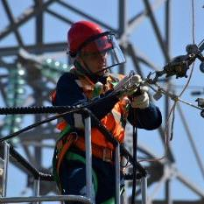
Advisory Committee on Apprenticeship (ACA) Meeting
May 10, 2023

Slide 2
Call to Order
Dr. Pam Eddinger
ACA Chairperson
Bunker Hill Community College
President

Slide 3
Member Roll Call – Employer Representatives
Noel Ginsburg, Employer Co-Chair, CareerWise Colorado
Amy Kardel, Senior Vice President, Strategic Workforce Relationships, The Computing Technology Industry Association (CompTIA)
Carolyn Holmes Lee, Executive Director, The Manufacturing Institute
T. David Long, CEO, National Electrical Contractors Association

Slide 4
Member Roll Call – Employer Representatives
Obed D. Louissaint, Senior Vice President and Chief People Officer, Aptiv
Karmela Malone, Senior Vice President of Claims, The Hartford
Timothy Oberg, Assistant Director, Independent Electrical Contractors
Valerie S. Richardson, Director, Talent & Workforce Development, Prisma Health

Slide 5
Member Roll Call – Labor Representatives
Raymond W. Boyd, Assistant Director of Education and Training, United Association of Journeymen and Apprentices of the Plumbing and Pipe Fitting Industry of the United States and Canada
Daniel Bustillo, Deputy Executive Director, 1199SEIU Training and Employment Funds, Service Employees International Union
John A. Costa, International President, Amalgamated Transit Union AFL-CIO/CLC

Slide 6
Member Roll Call – Labor Representatives
Stephanie Harris-Kuiper, Executive Director of the Training & Development Fund District 1199J, American Federation of State, County & Municipal Employees
William K. Irwin Jr., Retired Executive Director, Carpenters International Training Fund
Michael C. Oathout, Director of Safety & Health, Apprenticeships and Scholarships, International Association of Machinists & Aerospace Workers

Slide 7
Member Roll Call – Labor Representatives
Vicki L. O’Leary, General Organizer and Director of Diversity, Ironworkers International
Bernadette Oliveira-Rivera, Labor Co-Chair, Laborers’ International Union of North America
Anton P. Ruesing, Executive Director of the International Finishing Trades Institute, International Union of Painters and Allied Trades
Todd W. Stafford, Executive Director, Electrical Training ALLIANCE

Slide 8
Member Roll Call – Public Representatives
Todd Berch, President of the National Association of State and Territorial Apprenticeship Directors (NASTAD)
Walter G. Bumphus, PhD, President and CEO, American Association of Community Colleges
Erin E. Johansson, Research Director, Jobs with Justice
Donna Lenhoff, Principal, Donna Lenhoff Associates representing Chicago Women in Trades

Slide 9
Member Roll Call – Public Representatives
Robbie Melton, PhD, Associate Vice President, Tennessee State University, Smart Global Technology Innovation Center
Traci R. Scott, Vice President of Workforce Development, National Urban League
Orrian Willis, Host & Senior Workforce Development Specialist, San Francisco Office of Economic & Workforce Development
Randi Wolfe, PhD, Host & Executive Director, Early Care & Education Pathways to Success

Slide 10
Member Roll Call – Ex Officio Representatives
Kevin Gallagher, Senior Advisor, Upskilling and Broadband, U.S. Department of Commerce
Amy Loyd, Assistant Secretary, Office of Career, Technical, and Adult Education (OCTAE), U.S. Department of Education
Amy Peterson, Senior Advisor, Industry Relations, U.S. Department of Energy

Slide 11
Member Roll Call – Ex Officio Representatives
Johnathan J. Gardner, Director, Human Capital Programs, and Chief Learning Officer, Department of Health and Human Services
Diane Shelley, Regional Administrator, U.S. Department of Housing and Urban Development
Paige Shevlin, Strategic Advisor, U.S. Department of Transportation

Slide 12
Welcome From The Chicago Hosts
Bernadette Oliveira-Rivera
Assistant Director for Training
Laborers’ International Union of North America (LiUNA)

Slide 13
Welcome From The Chicago Hosts
Donna Lenhoff
Principle
Donna Lenhoff Associates
representing Chicago Women in Trades (CWIT)

Slide 14
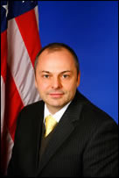
Agenda Overview
John V. Ladd
US Department of Labor
Administrator | Office of Apprenticeship
Employment and Training Administration
Designated Federal Official (DFO)

Slide 15
Agenda Overview - 1
8:45 a.m. – 9:30 a.m. | Call to Order Pam Eddinger, ACA Chairperson Welcome and Member Role Call Welcome from the ACA Chicago Hosts Bernadette Oliveira-Rivera, Assistant Director for Training, Laborers’ International Union of North America (LiUNA) Donna Lenhoff, Principle, Donna Lenhoff Associates, representing Chicago Women in Trades (CWIT) Agenda Overview John Ladd, Administrator, Designated Federal Officer Office of Apprenticeship, Employment and Training Administration Reflections: Local Apprenticeship Stakeholders John LeConche, Executive Director, National LiUNA Training and Education Fund Terry Healy, LiUNA Vice President, and Great Lakes Regional Manager Bilqis Jacobs-El, Director of Cook County Department of Facilities Management Departmental Remarks and Updates Brent Parton, Acting Assistant Secretary, Employment and Training Administration Group Photo ( if photographer available)

Slide 16
Agenda Overview - 2
9:30 a.m. – 10:15 a.m. | 30-Minute Moderated Panel: Innovations and DEIA Impacts in Apprenticeship for the Building Trades Co-Moderators: Bernadette Oliveira-Rivera, Assistant Director for Training, LiUNA Jayne Vellinga, CWIT Executive Director Presenters: Leonard Gonzalez, LiUNA and Department of Corrections Partnership featuring two apprentices: Afra Aldakak and Jose Hernandez Dan Penski, Director of Training and Apprenticeship, Finish Trades Institute of District Council #14 Chicago Miles Beatty, Executive Director, Finishing Contractors Association of Chicago Helen Chung, Organizer, Painters’ District Council #14 15-Minute ACA Members Feedback and Open Dialogue
10:15 a.m. – 10:30 a.m. | BREAK

Slide 17
Agenda Overview - 3
10:30 a.m. – 12:00 p.m. | Family Sustaining Wages Discussion – continued Opening Instructions and Recap from March 30th Meeting; Pam Eddinger, ACA Chair (3-5 minutes); Perspectives from Subcommittees (3 minutes per Subcommittee) Open Discussion including statements from individual members and/or items for the record (30 minutes) Full Committee Vote(s) (if needed) Adequate Discussion/Info to Move Forward? Possible Recommendations (if any)
12:00 p.m. - 1:00 p.m. | LUNCH

Slide 18
Agenda Overview - 4
1:00 p.m. – 2:30 p.m. | Subcommittee Meeting Report Outs Promoting DEIA in Registered Apprenticeship Summary of Final Issue Paper (3-5 minutes) Highlight Changes from the March Meeting (2-3 minutes) Open Discussion and Full Committee Vote (12-15 minutes) Apprenticeship Pathways Summary of Final Issue Paper (3-5 minutes) Highlight Changes from the March Meeting (2-3 minutes) Open Discussion and Full Committee Vote (12-15 minutes) Industry Engagement in New and Emerging Industries Summary of Final Issue Paper (3-5 minutes) Highlight Changes from the March Meeting (2-3 minutes) Open Discussion and Full Committee Vote (12-15 minutes) Apprenticeship Modernization Summary of Final Issue Paper (3-5 minutes) Highlight Changes from the March Meeting (2-3 minutes) Open Discussion and Full Committee Vote (12-15 minutes)

Slide 19
Agenda Overview - 5
2:30 p.m. - 2:45 p.m. | Break
2:45 p.m. – 3:30 p.m. | Biennial Report: Full Committee Discussion and Action Review and Discussion of Biennial Report Full Committee Vote
3:30 p.m. - 3:50 p.m. | Open Discussion and Next Steps Interim Report Updates Charter Expiration / Renewal Membership Nominations Road Ahead
3:50 p.m. – 4:00 p.m. | Meeting Wrap Up Public Comment Adjourn

Slide 20
Reflections: Local Apprenticeship Stakeholders
John LeConche
Executive Director
National LiUNA Training and Education Fund

Slide 21
Reflections: Local Apprenticeship Stakeholders
Terry Healy
LiUNA Vice President and Great Lakes Regional Manager

Slide 22
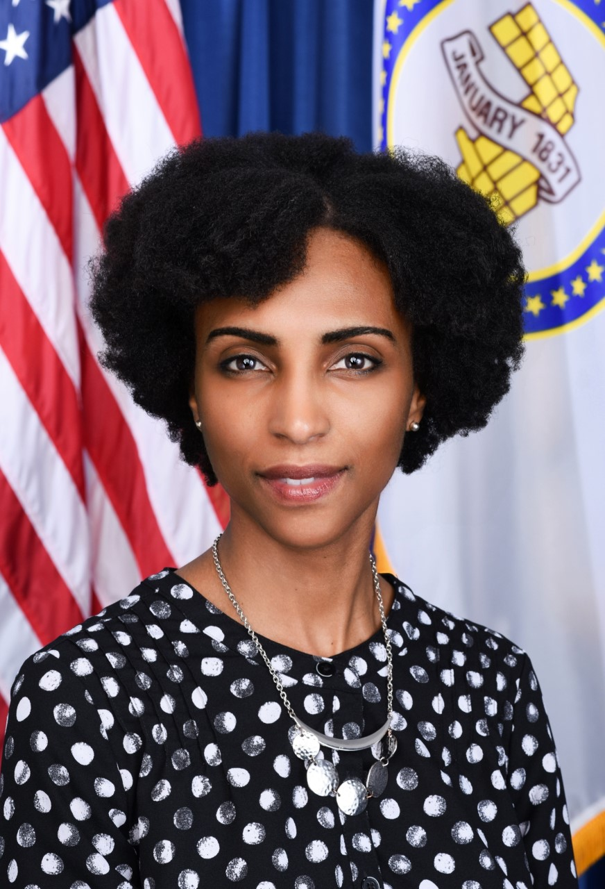
Reflections: Local Apprenticeship Stakeholders
Bilqis Jacobs-El
Director of Cook County Department of Facilities Management

Slide 23
Departmental Remarks and Updates
Brent Parton
US Department of Labor
Acting Assistant Secretary
Employment and Training Administration

Slide 24
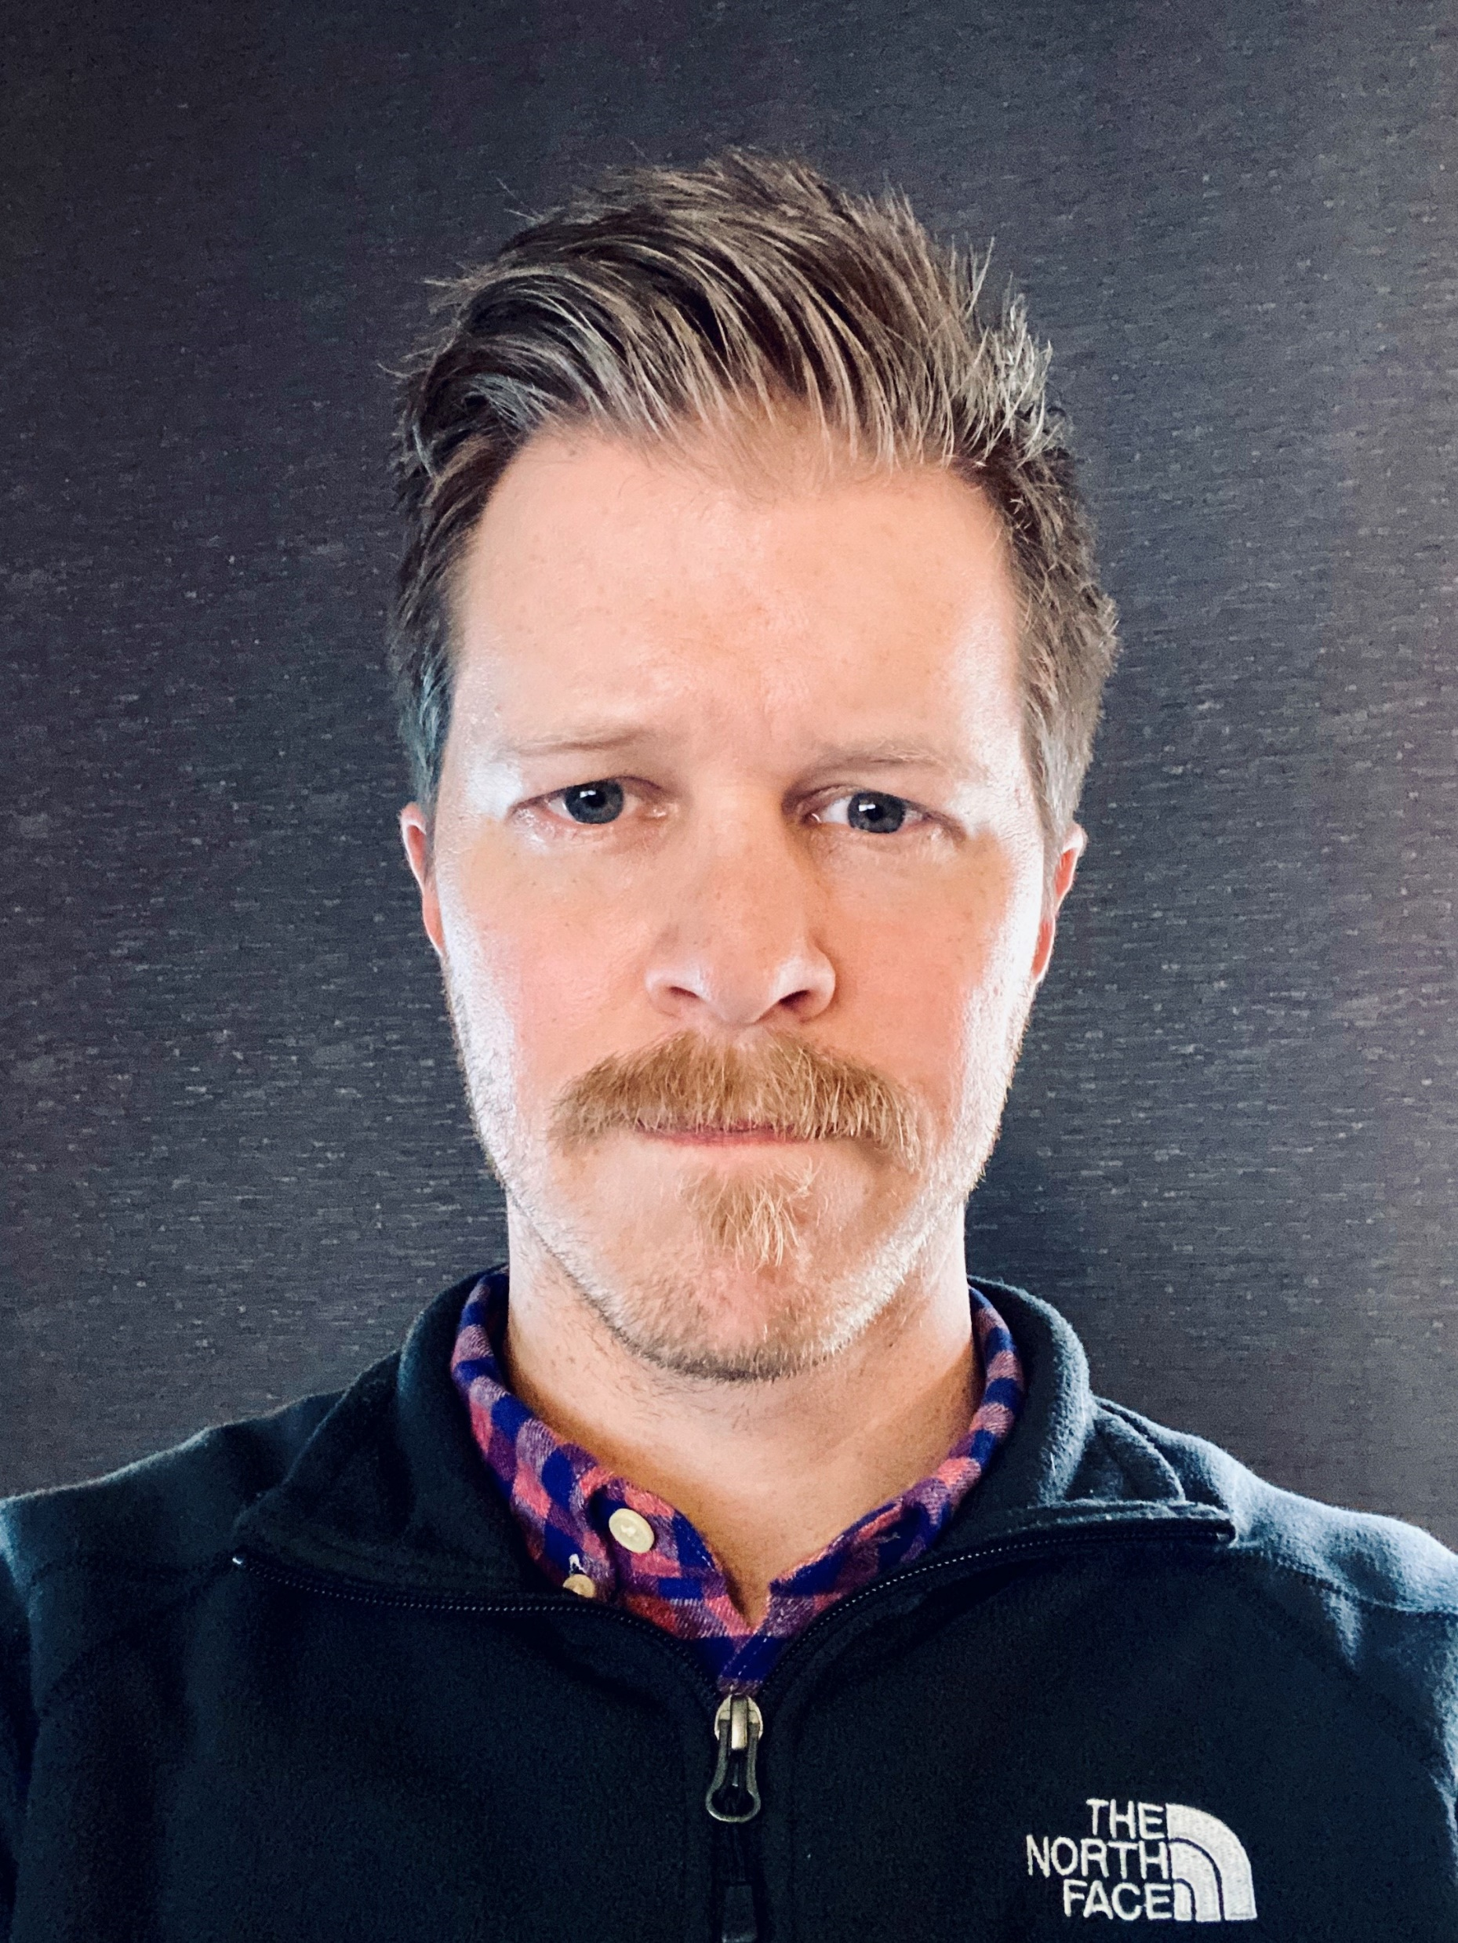
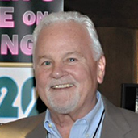
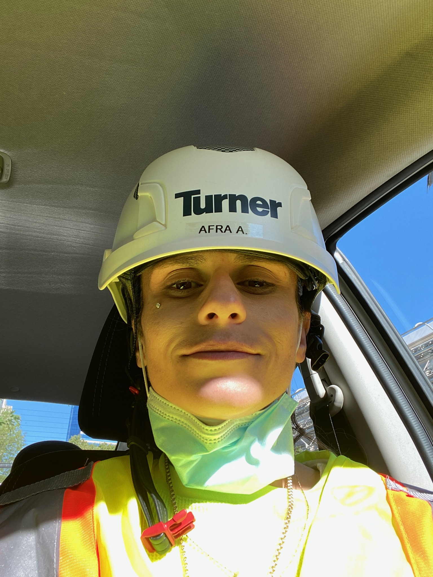
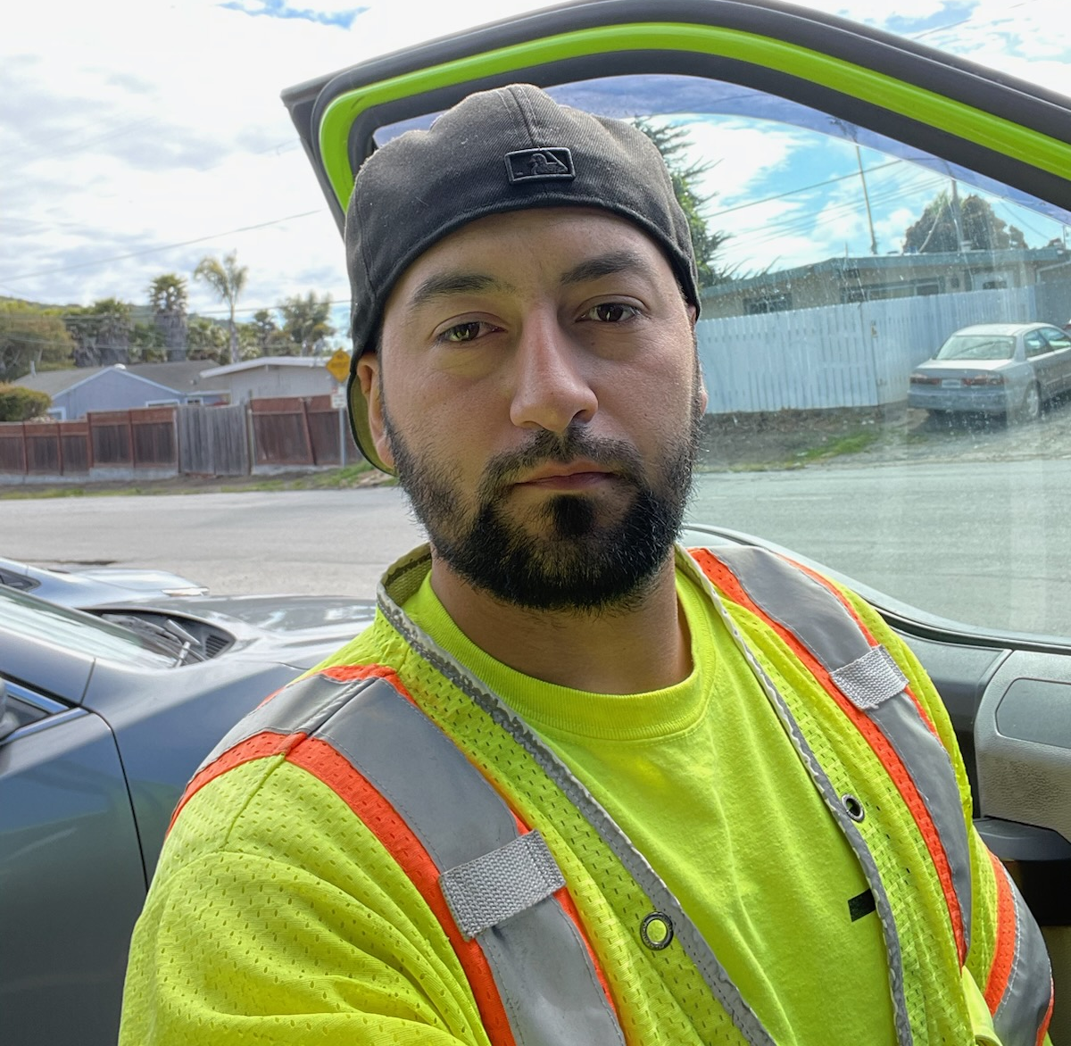
30-Minute Moderated Panel: Innovations and DEIA Impacts in Apprenticeship for the Building Trades
Co-Moderators
Bernadette Oliveira-Rivera, Assistant Director for Training, LiUNA
Jayne Vellinga, CWIT Executive Director
Presenters
Apprentices
Dan Penski
Director of Training and Apprenticeship
Finish Trades Institute of DC 14 Chicago
Miles Beatty
Executive Director
Finishing Contractors Association of Chicago
Helen Chung
Organizer
Organization
Painters’ District Council #14
Leonard Gonzalez
LIUNA and Department of Corrections Partnership
Afra Aldakak
Jose Hernandez

Slide 25
Break

Slide 26
Family Sustaining Wages Discussion - continued

Slide 27
Family Sustaining Wages Discussion - continued
Opening Instructions and Recap from March 30th Meeting;
Pam Eddinger, ACA Chair (3-5 minutes)
Perspectives from Subcommittees (3 minutes per Subcommittee)
Open Discussion including statements from individual members and/or items for the record (30 minutes)
Full Committee Vote(s) (if needed)
Adequate Discussion/Info to Move Forward?
Possible Recommendations (if any)

Slide 28
Pathways Subcommittee: Implications/Operationalization on Wages
RAPs must include a progressive wage scale for all work performed throughout the apprenticeship, including in-school youth apprenticeships.
RAPs should result in a living wage at completion and lead to long-term financial growth and stability for the participant.
The tool used to calculate a living wage should be one that is updated annually for inflation, accounts for regional differences in cost of living, and is evidence-based.

Slide 29
DEIA: Implications/Operationalization on Wages
The DEIA subcommittee remains steadfast in the commitment to the public vote of the ACA committee on March 30, 2023 and the principles of the “Good Jobs Initiative” jointly developed by the Department of Commerce and Department of Labor which include living wages.
The DEIA subcommittee use living wages and family-sustaining wages interchangeably and define this term as wages which allow workers to earn enough to afford adequate shelter, food, and other necessities based on local geographic area.
It is imperative that we address the issue of living wages as an equity issue to avoid another economic collapse with disproportionate impact based on race, gender, ability, and residence.
Apprenticeships have long been a pathway to gain valuable skills and secure high-paying jobs, but for many women and African Americans, apprenticeships fail to deliver on these promises.
African American men make the lowest wages of any men apprentices upon completion due to a higher concentration in lower paying jobs. African Americans also have lower completion rates.
Women account for only 14% of all registered apprentices and are concentrated in lower paying service jobs. Women earn only 2/3s of what men earn, making on average $10 less per hour.
On completion all women apprentices make even less than African American men, and African American women make the lowest wages on completion of any group.
“One Apprenticeship, Stackable Credentials” define a clear, workable pathway to living wages.
Need to track progress along career pathway and provide support.

Slide 30
IENES Group 1: Living Wage Considerations
A Registered Apprenticeship must end with a living wage, provide family sustaining benefits, and adhere to the other principles laid out by the Departments of Commerce and Labor as Good Jobs Principles.
The living wage requirement should apply to all workers, including those participating in apprenticeship as part of their K-12 academic experience.
An apprenticeship program may offer workers industry recognized credentials that enable them to work in certain jobs that are not apprenticeable occupations as part of their apprenticeship experience.
A job/position that currently exists in the marketplace, which does not pay workers a living wage, but which gives them foundational knowledge and skills that can be helpful to them in entering a related apprenticeable occupation can be developed as a pre-apprenticeship to apprenticeship pathway.
Sponsors in new and emerging sectors that have multiple apprenticeship programs for various occupations all of which pay a living wage, can create pathways for apprentices to continue to grow and to meet DEIA and industry needs.
See addendum for non-consensus views submitted by the subcommittee.

Slide 31
IENES Group 2: AREAS AROUND WHICH TO DEVELOP ADDITIONAL RECOMMENDATIONS RELATED TO WAGES AND REGISTERED APPRENTICES
Clarifying that a “wage threshold” would primarily apply to Apprenticeability vs. Individual Programs.
It is not clear how Family Sustaining Wages (FSW) becoming a determinant for the apprenticeability of occupations would work in practice.
While DOL cannot mandate wages, it can and does use wages currently as one of the criteria for determining apprenticeability (e.g., requirements around wage scales and prevailing wages).
Interim (Stackable) Credentials, as opposed to Stackable Apprenticeships.
There is a lack of definition around stackable apprenticeship onramps and offramps, what would be considered a completer and how that impacts DOL investment strategies and priorities.
Career Pathways are an essential strategy for building our middle class. By integrating registered apprenticeship into pathway development, we create more equity by allowing participants to earn and learn. Further, when apprenticeships are stacked in a pathway, the pathway is more approachable for workers from diverse backgrounds.
Other Specific Wage-related Issues to be clarified.
Without the definition and additional data to see if apprenticeships are leading to family sustaining wages, it isn’t reasonable to request or require apprenticeship programs to achieve these wages before program completion. This could lead to the opposite of DOL’s goal of encouraging more industries and companies to adopt Registered Apprenticeships.
Since the concept of FSW is based on family structure, how would we impose that standard on an apprenticeship in which the apprentices represent a variety of family structures?
There could be constitutional issues or civil rights or EEO violations arising from implementing a FSW requirement, particularly insofar as it disadvantages particular groups of with families.
There would be a marketing problem if employers were told what they are required to pay in order to work with registered apprenticeships, as wages are currently only recommended in the Schedule D of Apprenticeship Standards.
Notes:
Would existing apprenticeable occupations be “grandfathered” in? If so, that could put an unfair and unreasonable burden on new occupations, while not holding existing occupations to the higher standard supposedly at the root of the FSW recommendation. And if existing apprenticeable occupations are not grandfathered in, there would need to be a system through which currently apprenticeable occupations could be “recertified” as apprenticeable once having proven they meet the FSW requirement. Additionally, there would need to be the infrastructure in place to execute that system.
Rather than applying an FSW wage threshold to apprenticeability determinations, DOL should consider a formula including criteria such as:
Is the occupation part of a pathway that leads to FSW?
Does the journey level wage equal a certain wage criteria (e.g., percentage of FSW, CA Employment Training Panel trainee wage scale, living wage, 2X poverty wage)?
Does the occupation require a post-secondary degree, Industry-Recognized Credential or License, etc., such that RAP certification could replace the current requirement?
Does the journey level role generally meet the criteria of the DOL’s Good Jobs principles?

Slide 32
Modernization: Implications/Operationalization on Wages
A Registered Apprenticeship Program must meet the following criteria in order to be deemed as being high quality:
Valuable outcomes
* * * * *
Programs with high completion percentages in which the journey-level wages are family-sustaining wages with benefits, allowing one adult to support 2 children, according to the MIT living wage calculator.
USDOL OA and the SAA’s should require comprehensive sharing of hourly wages. If a state declines to participate they should not be included in federal grant funding for RAP’s. Wage information can be supplied by participating states through wages of apprentices upon completion of their apprenticeship through RAPIDS or through a state’s internal apprenticeship data management system.
USDOL OA and the SAA’s should require wage verification as part of the Quality and Compliance Review process. These results should be included as part of a wage study conducted by USDOL where applicable for grants and other USDOL/SAA studies.

Slide 33
Lunch

Slide 34
Subcommittee Meeting Report Outs

Slide 35
Promoting Diversity, Equity, Inclusion, and Accessibility (DEIA) in Registered Apprenticeship
ACA Subcommittee

Slide 36
Summary of Final Issue Paper
Use Leading Indicators to Proactively Support a Healthy Culture of Inclusion
Initiate Systematic Assessments Focused on People, as well as Programs
Establish Data-driven Feedback Loop to Measure Progress and Implement Change
Make Sure to Connect All Apprentices with “Good Jobs”

Slide 37
Highlight Changes from the March Meeting
“One Apprenticeship, Stackable Credentials” define a clear, workable pathway to living wages
Need to track progress along career pathway and provide support
Harassment, Discrimination, Bullying, and Intimidation prevalent
72% of Black respondents and 66% of women experience discrimination or prejudice and work (National Institute of Building Sciences)
Women truckers 2-4x more likely to be touched without permission and minority women up to 9x more likely to be physically harmed (Bloomberg Law Daily Labor Report)
Particularly disturbing is finding that 90% of individuals who say they have experienced harassment never take formal action against the harassment (EEOC Harassment Study)
(A registered apprenticeship must end in a family sustaining wage.
ACA voted to approve with only one member voting no and five abstaining.
Living wages are a critical issue – especially in terms of equity and impact based on gender, race, and ethnicity
DEIA subcommittee uses Living wages and family-sustaining wages interchangeably
Definition: wages which allow workers to earn enough to afford adequate shelter, food, and other necessities based on local geographic area.)

Slide 38
Open Discussion and Full Committee Vote

Slide 39
Apprenticeship Pathways
ACA Subcommittee

Slide 40
Summary of Final Issue Paper
Overcome bias toward college/classroom learning to the exclusion of work-based/experiential learning
Remove barriers to registration to help improve programs’ access to the apprenticeship system while maintaining quality
Identify and address special considerations for youth participants in apprenticeship (e.g., greater need for supportive services)
Retool data and reporting to provide a fuller/more accurate picture of youth apprenticeship
Clearly define youth apprenticeship to help support its expansion by clarifying requirements
Recognize DOL as an accrediting agency to save apprenticeship programs time and money

Slide 41
Highlight Changes from the March Meeting
Throughout the issue paper, clarified references to post-secondary education and college
Added language about DEIA to issue and background section and recommendations on data, definitions, and investment
Noted community-based organizations’ role in youth apprenticeship and recommended more funding for them and other stakeholders
Removed specific numbers from recommendation around instructor to student ratios
Removed recommendation related to stackable apprenticeships
(Added recommendation that RAPs include a progressive wage scale for all work (including in-school youth apprenticeships), result in a living wage at completion, and lead to long-term financial growth and stability)

Slide 42
Open Discussion and Full Committee Vote

Slide 43
Industry Engagement in
New and Emerging Sectors
ACA Subcommittee

Slide 44
Industry Engagement in New and Emerging Sectors Subcommittee Issue Paper Topic
Title: Registered Apprenticeship Career Pathways in New and Emerging Industries
Issue and Background: How do we use registered apprenticeship to create career pathways for apprentices in new and emerging sectors, without compromising the quality and rigor of the registered apprenticeship system, and ensuring and enabling awareness and access for historically marginalized populations?

Slide 45
Updates to the Issue Paper
Incorporated feedback from other subcommittees
Updated recommendation on Apprenticeship Pathway Framework Tool to include that training to use the tool should be offered widely to stakeholders
Recommended that DOL should create a mechanism to track and research the effectiveness of apprenticeship pathways
Added references to the kinds of stakeholders DOL should be working (employers, organized labor, community partners, etc.) with to create opportunities for historically marginalized populations.
Expanded on recommendation on marketing apprenticeship to specify that DOL should also market apprenticeship to employers.
(Removed references to wages in the main issue brief, and added addenda with non-consensus views on the subject of family sustaining wages in apprenticeship.)

Slide 46
Recommendations, Best Practices and Definitions
Invest in marketing and outreach in new and emerging industries and to historically marginalized communities
Invest in the R&D of an Apprenticeship Pathways Framework Tool
Develop a tracking mechanism to assess the effectiveness of these new investments and strategies
To advance best practice, we need definitions and agreement on key terms.
As a best practice model, we would like to highlight programs in public transit, where RAP completers have priority when applying for higher wage positions.
The DOL should investigate the potential of creating a U.S. National Qualifications Framework.
Notes:
Identification of relevant best practices
We have to employ recruitment and outreach strategies that ensure that we are effectively targeting workers in new and emerging sectors and reaching the historically marginalized populations we hope to engage (e.g., advertise in the right places and to the right communities).
Recommendations for DOL investment
DOL should create a mechanism to track and research the effectiveness of apprenticeship pathways in supporting worker access to upward career mobility, particularly for historically marginalized populations.
DOL should invest in marketing needed for the apprenticeship system and make clear to targeted communities how individuals can achieve upward economic mobility. DOL should also invest in marketing to employers, to make the case that by participating in RA there is a ROI for employers in engaging historically marginalized populations and making career pathways available, especially in new and emerging sectors.
OA needs to create a map of occupations within a given sector and identify worker pathways from one sector to another. The map should show how an individual can increase their wages along a pathway either within an industry or between industries.
OA should consider investing in development of an Apprenticeship Pathways Framework Tool to support workers and their economic growth and mobility. DOL should also make training for this tool widely available to stakeholders (e.g., ETA grantees, apprenticeship sponsors, and intermediaries among others). Lack of a career mobility tool is a challenge for current and former apprentices as well as those looking to enter a registered apprenticeship program. They do not have a way to determine their career paths, promotional opportunities, and future employment prospects, whether in a given occupation, sector or across various sectors.
Recommendations for innovation
To advance best practice, we need definitions and agreement on key terms.
Pathways and career pathways
Occupational segregation
Rigor and quality
Family sustaining wages (FSW)
Living wage [national vs within a state vs by municipality]
As a best practice model, we would like to highlight the transit worker programs in Kansas City and Indianapolis. Individuals who have completed a RAP have priority when applying for higher wage positions.
Other relevant items the subcommittee wants to report for ACA consideration.
U.S. National Qualifications Framework
As a supplement to the Apprenticeship Pathways Tool, the DOL should investigate the potential of creating a U.S. National Qualifications Framework.
DOL should recruit a task force (or support the recently created U.S. QF) to comprehensively engage private sector, organized labor, education institutions, workforce development stakeholders, training providers, international leaders on the potential development of a U.S. National Qualifications Framework. Frameworks are critical when considering the mapping of career pathways and necessary to ensure the quality, rigor, and consistency of the education and training regimen.

Slide 47
Open Discussion and Full Committee Vote

Slide 48
Apprenticeship Modernization
ACA Subcommittee

Slide 49
Summary of Final Issue Papers/Recommendations
Quality Standards - Issue a Training and Employment Notice (TEN) or other policy defining Quality Guidelines for RAPs
Marketing Apprenticeship - Provide a substantial marketing budget to be used to raise awareness of apprenticeship among employers, job seekers, and school staff
Onboarding New Programs - DOL to streamline the process to onboard apprenticeship by digitizing applications, standardizing expectations, and using Rapids data to identify successful procedures

Slide 50
Highlight Changes from the March Meeting
Quality Standards:
Addressed occupational segregation
New methods for wage information to be supplied by participating states
Added section on sector-based strategies
Marketing Apprenticeship:
Addressed DEIA concerns regarding marketing to potential apprentices
Added marketing outreach in community organizations, colleges, and high schools
Included that youth and adult apprenticeship could make college more affordable
Onboarding New Programs: No changes

Slide 51
Open Discussion and Full Committee Vote

Slide 52
Break

Slide 53
Biennial Report: Full Committee

Slide 54
Options Available to the Committee
ACA approves the Biennial Report with only the addition of the strategic frameworks statements approved at the last meeting.
DOL utilizes final report recommendations with strategic framework statements for guidance/input from the Committee
Continued work on all issue papers carries over into next term
ACA approves the Biennial Report with the addition of the strategic frameworks AND any (or all) issue papers that have been approved at the May ACA meeting
DOL utilizes final report recommendations with strategic framework statements and any approved issue papers for guidance/input from the Committee
Continued work on unapproved issue papers and any other items recommended by ACA carries over into next term

Slide 55
Open Discussion and Full Committee Vote

Slide 56
The Road Ahead and Next Steps

Slide 57
The Road Ahead and Next Steps
Interim Report Update
Charter Expiration / Renewal
Membership Nominations
Road Ahead

Slide 58
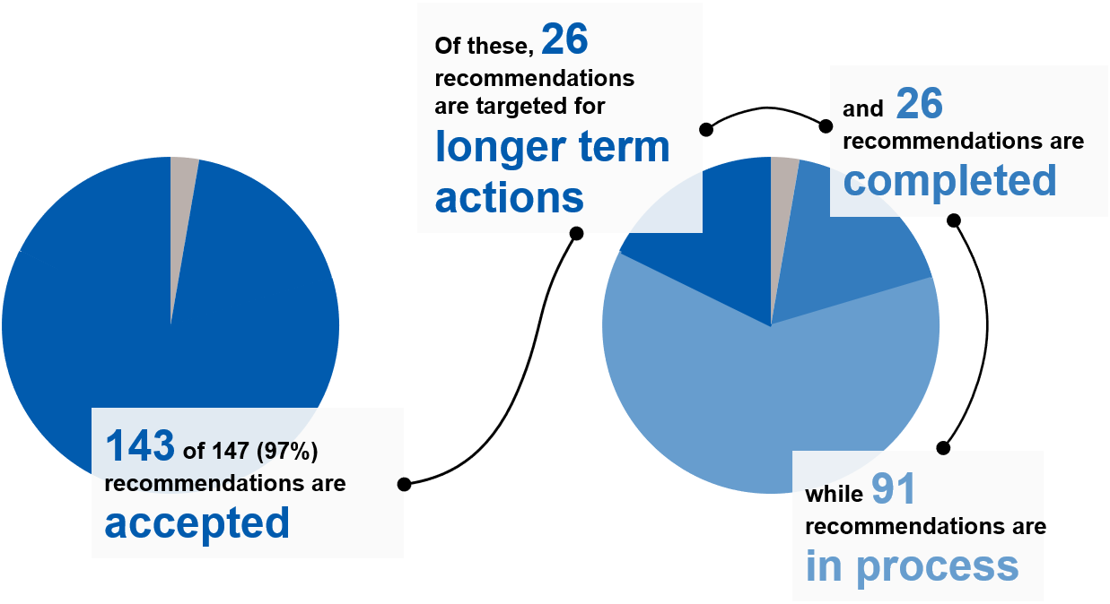
Interim Report Recommendations Status Update

Slide 59
Interim Report Implementation Highlights
DEIA
Pathways (Items below in progress)
Increased staff capacity to support oversight and enforcement efforts
Launched national apprenticeship readiness initiative to support DEIA efforts in construction industry
Launched Demographic Dashboards
Automated reminders to RA Sponsors regarding EEO obligations
Continued work with DEIA TA Center
Update Pre-Apprenticeship TEN
Expand Partnership and Coordination with Department of Education, particularly with relation to CTE
Partnership opportunities to expand Youth Apprenticeship in Federal Government
Disaggregate youth data to distinguish between in-school and out-of school youth.
Updates to Educator Pages on apprenticeship.gov

Slide 60
Interim Report Implementation Highlights
Modernization
IENES
Made all RAPIDS data publicly available via Data Dashboards
Updated and/or launched on-line tools including Standards Builder and Online Apprenticeability Request (OAR) Tool
Launched updating of Apprenticeship Regulations based in part on ACA recommendations (ongoing)
Apprenticeship Ambassadors
Re-Launched Apprenticeship.USA
Refreshed Apprenticeship.gov based on user experience
Continued expansion of Intermediaries
Launched Industry Liaisons
Established Formula Funding for States

Slide 61
Road Ahead
Charter Renewal: Anticipate public notice of charter renewal later this month
Membership Solicitation: Anticipate solicitation for nominations by end of month.
All ACA members interested in serving an additional 2 year term should re-submit their nomination materials
Note: Application process will be electronic and materials should be submitted via portal info program.
Membership Announcements: TBD (Summer/Fall)
Next ACA Meeting: TBD (Fall)

Slide 62
Public Comment

Slide 63
Adjourn

